Slide 1

How to query datasets
Aniket Prasad and Satyapriya Das

Slide 2
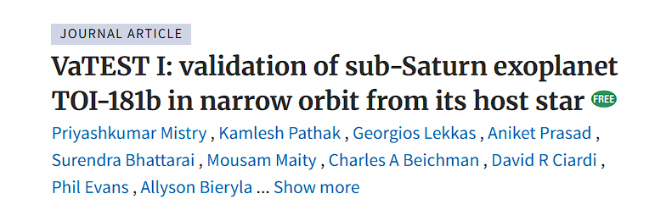
Positioning of the object
Nomenclature of Objects
Right Ascension and Declination : Sky coordinates
Galactic latitude and longitude: Another Sky coordinates
Different telescope surveys catalogue the objects with numbers
Pulsars: PSR J0034-0721, Exoplanets: TOI 181b K 223b, Galaxies: NGC 2024, M 87

Slide 3
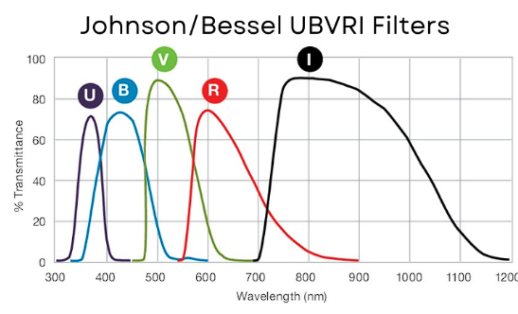
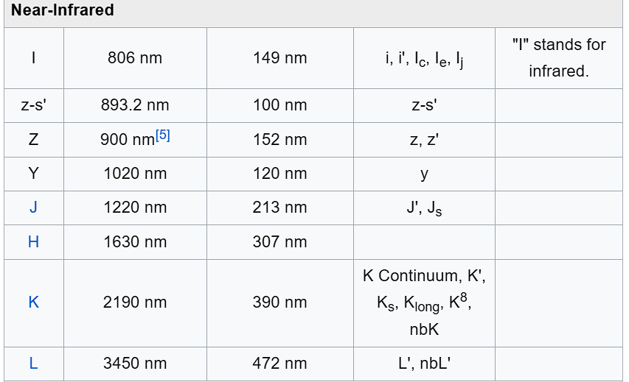
Filters

Slide 4
Types of Data
Photometry
Spectroscopy
Time series
Polarimetry
Data cube

Slide 5
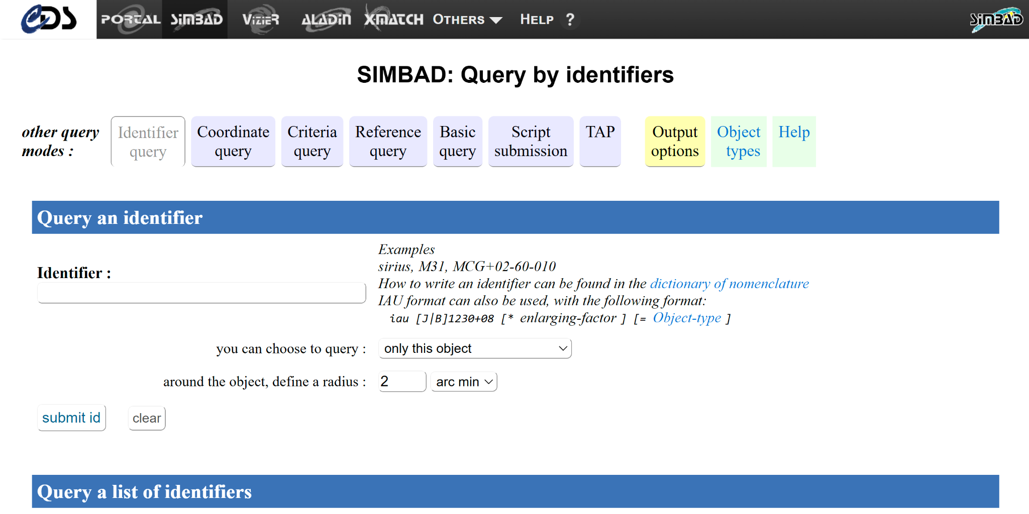
SIMBAD: To know the name

Slide 6
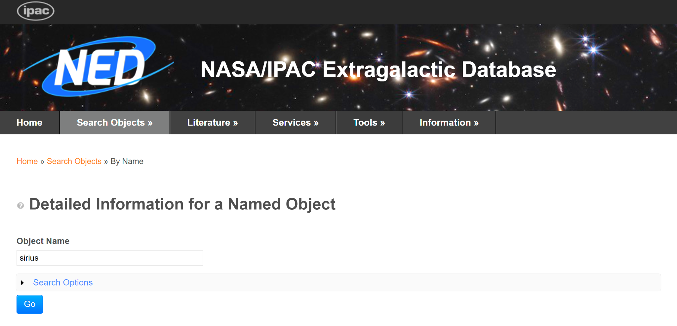
NED: To know the names

Slide 7
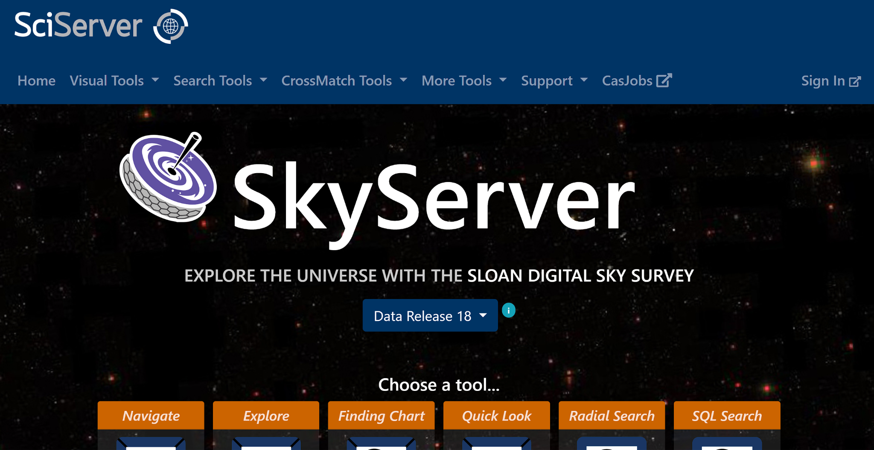
Skyserver: https://skyserver.sdss.org/dr18/
Follow the page:
https://www.sdss.org/dr18/tutorials/
Used for SDSS FITS files
Can download the image and spectra

Slide 8
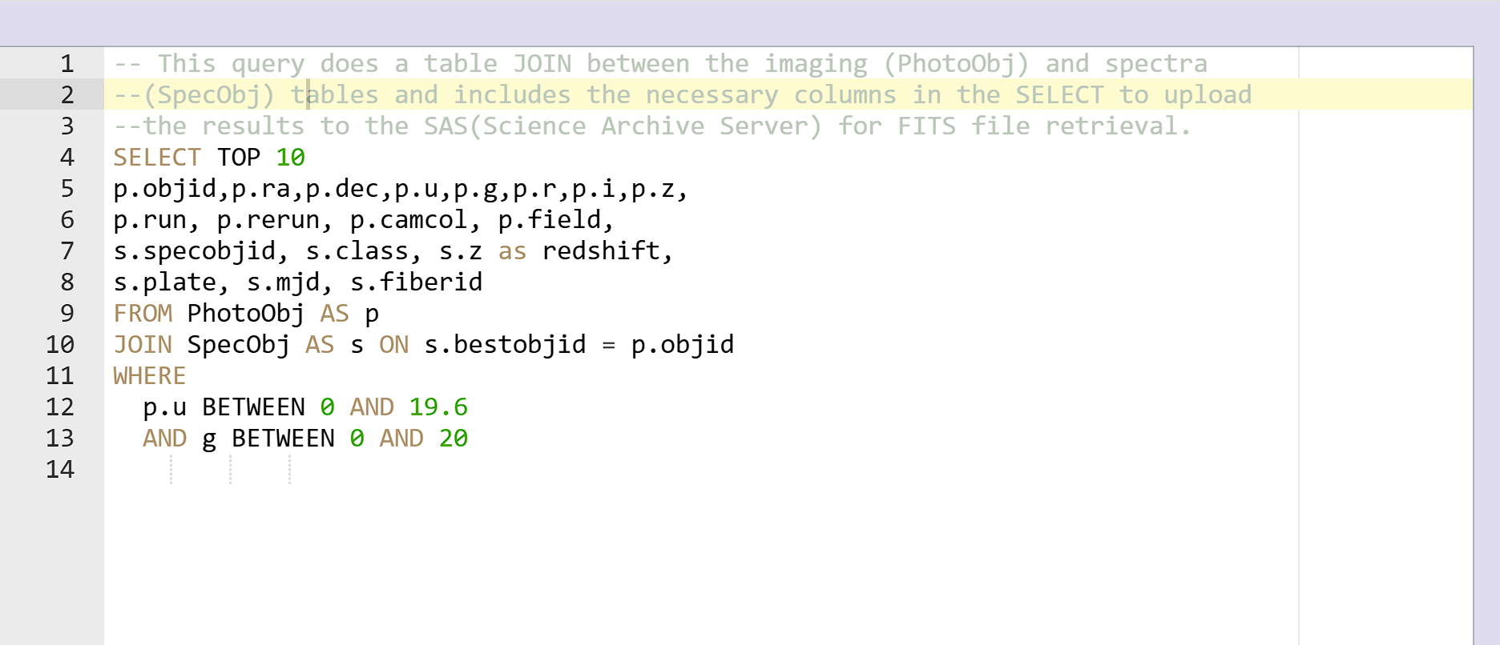
SQL search for multiple object in SDSS
https://skyserver.sdss.org/dr18/en/tools/search/sql.aspx
One can learn about SQL from: https://www.w3schools.com/sql/

Slide 9
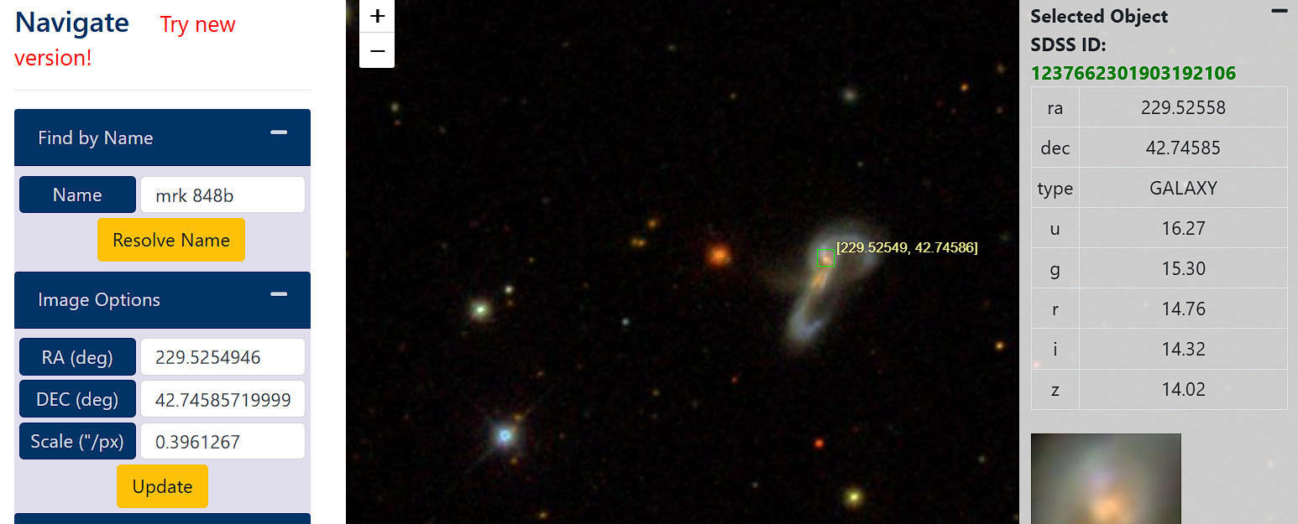
SDSS J151806.13+424445.0 which is Mrk 848

Slide 10
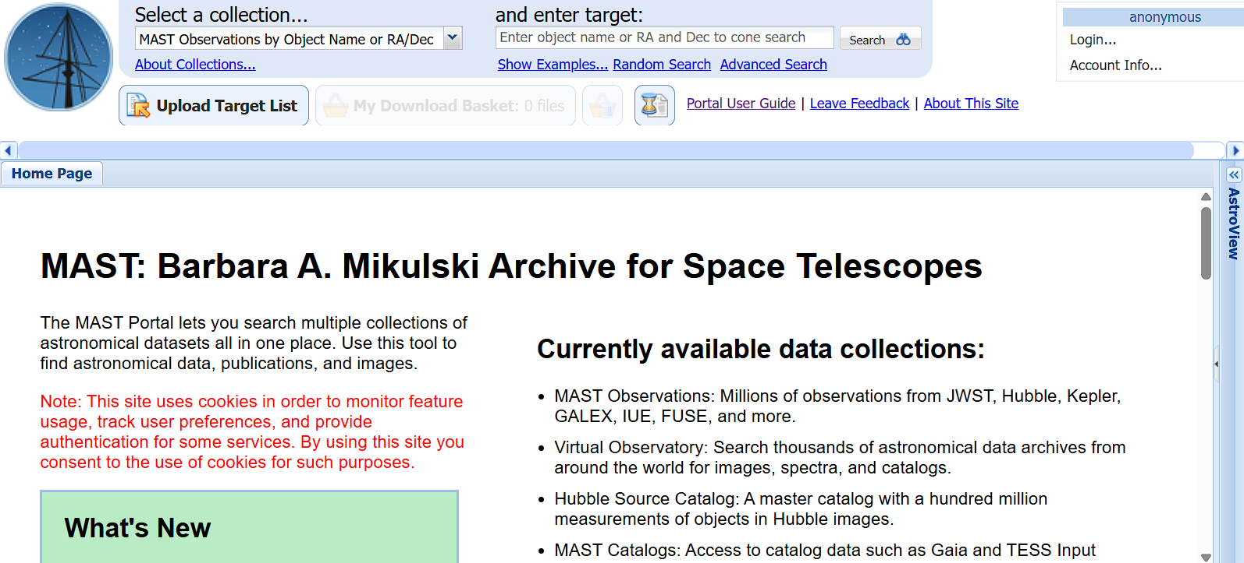
MAST: JWST/Exoplanet Data download
https://mast.stsci.edu/portal/Mashup/Clients/Mast/Portal.html

Slide 11
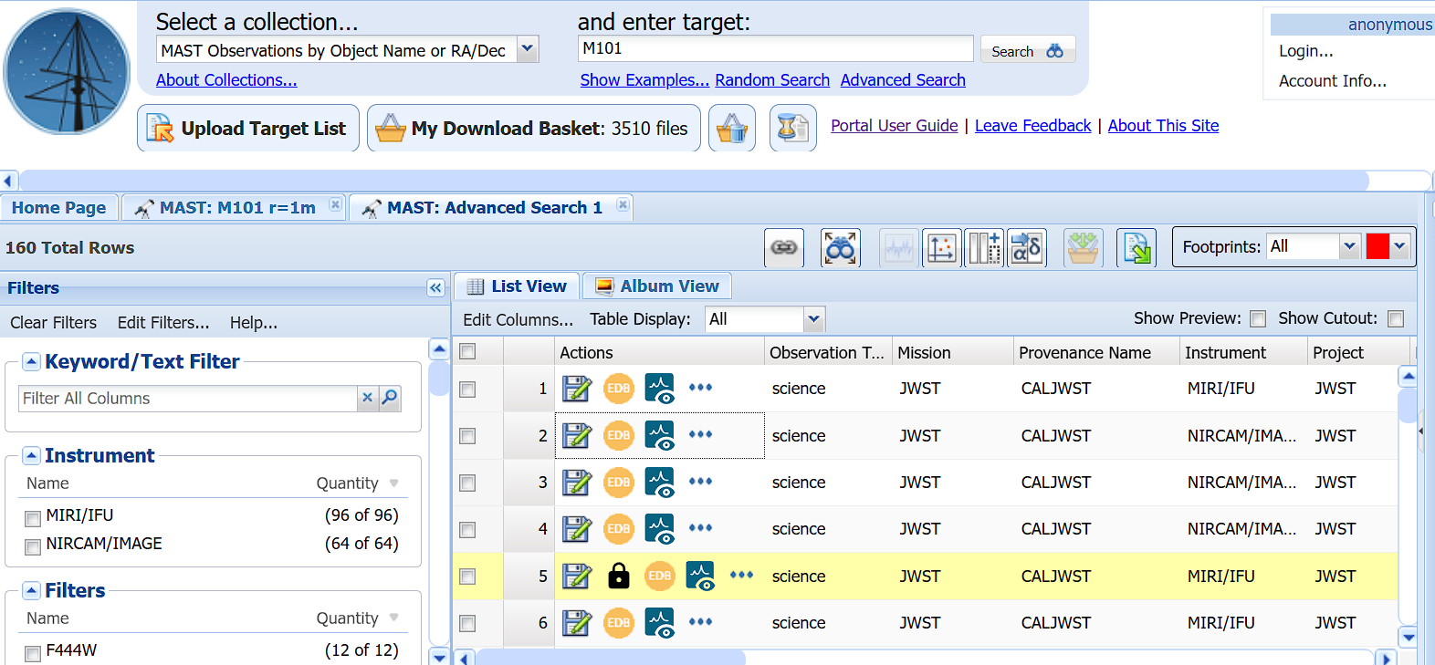
For viewing online

Slide 12
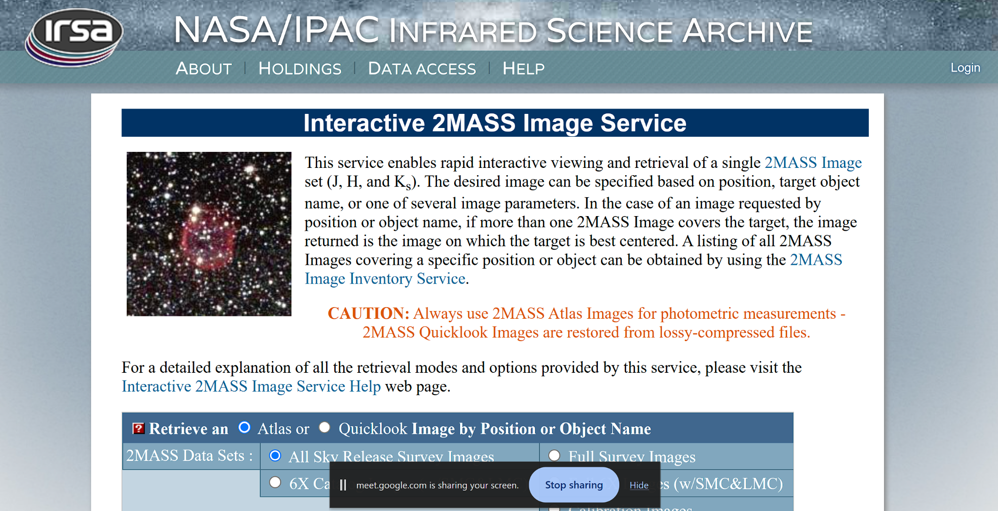
For you to explore images: 2MASS
https://irsa.ipac.caltech.edu/applications/2MASS/IM/interactive.html

Slide 13
Try to make RGB images:
Check the images in this site:
https://www.ipac.caltech.edu/2mass/gallery/images_ysos.html
Search the object in 2MASS database (For ex: T Tauri) for Atlas images
Download the 3 filter data it has options of.
Try to make RGB imaging with proper scaling (can use Python or DS9)
The Image you might be getting is also shown in the link above. Make your own RGB and compare!!!!

Slide 14
Other databases to explore
NASA Exoplanet Archive
https://exoplanetarchive.ipac.caltech.edu/docs/data.html
High Energy Data (X-ray Missions)
https://heasarc.gsfc.nasa.gov/xamin/
Some Solar data
https://sdo.gsfc.nasa.gov/
Gaia data archive
https://www.cosmos.esa.int/web/gaia/dr3 (follow the steps in the page to go to archive)

